Slide 1
An Empirical Investigation into Learning Bug-Fixing Patches in the Wild via Neural Machine Translation
Michele Tufano, Cody Watson, Gabriele Bavota, Massimiliano Di Penta, Martin White, and Denys Poshyvanyk. 2018
Proceedings of the 2018 33rd ACM/IEEE International Conference on Automated Software Engineering (ASE ’18)
2019 /11/15
Ju Hyoung Kim

Slide 2
Abstract
Millions of open-source projects with numerous bug fixes are available in code repositories.
This proliferation of software development histories can be leveraged to learn how to fix common programming bugs.
Perform an empirical study to assess the feasibility of using Neural Machine Translation techniques(NMT) for learning bug-fixing patches for real defects.
Abstract the buggy and corresponding fixed code, and use them to train an Encoder-Decoder model able to translate buggy code into its fixed version.

Slide 3
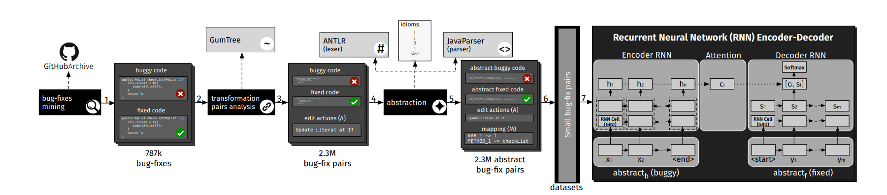
Approach

Slide 4
Approach 〮Bug-fixes Mining
Using github archive and google bigQuery APIs to identify all comits having a message containing the patterns (“fix”or”solve”) and(“bug”or”issue”or”problem”or”error”)
Two authors independently analyzed a statistically significant sample for Precision(real fixing check)
Extracted the source code before and after the bug-fix .
(collect the buggy and the fixed code)
Except non java failes, created bug fixing commit, more than five Java files
( Aim to learn focused bug-fixes Not spread across the system)

Slide 5
Approach 〮Bug-fixes pairs analysis (Extraction)
BFP(bug-fixing pair) = (mb,mf) = (buggy code,fixed code)
Use these BFPs to train the NMT model, learning the translation from buggy to fixed code for generating patches.
Separate the code into method-level
1.Methods represent a reasonable target for fixing activities, since they are likely to implement a single task or functionality.
2. Methods provide enough meaningful context for learning fixes.
3. Considering arbitrarily long snippets of code makes learning more difficult given the variability in size and context
L = {(m1b ,m1f ), . . . ,(mnb ,mnf )}. Mapped pairs of methods.

Slide 6
Approach 〮Bug-fixes pairs analysis(Extraction)
Extract a sequence of edit actions. output of this phase is a list of BFPs = {b f p1, . . . ,b f pk }
b f p = {mb ,mf ,A} (buggy method, fixed method, edit actions)
Exclude methods created/deleted during the fixing
- It should be noted that the process we use to extract the BFPs
1. does not capture changes performed outside methods
2. considers each BFP as an independent bug fix.

Slide 7
Approach 〮Bug-fixes pairs analysis(Abstraction)
Learning patterns challenging due to the huge vocabulary of terms
To deal with, abstract the code and generate an expressive yet vocabulary-limited representation.
Use a java lexer and a parser to represent each buggy and fixed method.
The Lexer, tokenizes the raw code into a stream of tokens, fed into a java parser, which discerns the role of each identifier and the type of a literal.
The parser generates and substitutes a unique ID for each identifier/literal within the tokenized stream. in case of multiple appear, mapping of identifiers/literals Same ID

Slide 8
Approach 〮Bug-fixes pairs analysis
- Bfpa = {abstractb,abstractf,A,M}
-M = ID mapping for particular BFP
Analyze the buggy code mb and corresponding fixed code mf
IDs are assigned to identifiers and literals in sequential
Method name : METHOD_1, METHOD_2, ect.
Variable name : VAR_X
Literals : (STRING_X, INT_X,FLOAT_X)
Abstractions are a stream of tokens consisting of language keywords(for,if) ,separators(“(“,”;”,”}”)
and IDs (identifiers and literals)
- Comments and annotations removed.

Slide 9
Approach 〮Bug-fixes pairs analysis
Some identifiers and literals appear so often, for our abstraction, can be treated as keywords of the language.
(variables I,j,or index used in loops, or literals such as 0,1,-1, used in conditional statements and return values)
Similarly, method name such as size or add, appear several times since they represent common concepts,
- These identifiers and literals are often referred to as “idioms”
- keep the original text when abstraction, not replace.
To define the list of idioms,
1. randomly sampled 300k BFPs and considered all their original source code.
2. extracted the frequency of each identifier/literal used in the code
3. discarding keywords,spearators,and comments
4. Analyze the distribution of the frequencies and focused on the top 0.005% words

Slide 10
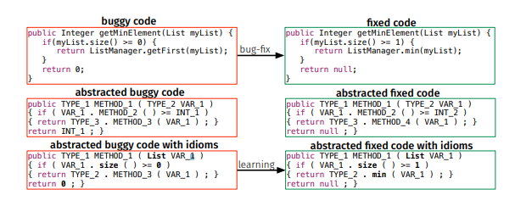
Approach 〮Bug-fixes pairs analysis
minimum value in a list of integers contains three errors
if-condition
getFirst method
Return value.

Slide 11
Approach 〮Bug-fixes pairs analysis
When we feed the buggy piece of code to the Java parser and Lexer, we identify some problems with the mapping.
.Abstracted fixed code contains INT_2 and METHOD_4, which are not contained in buggy code
Since the mapping of tokens to code is solely reliant on the buggy method, this example would require the synthesis of new values for INT_2 and METHOD_4.
Takes advantage of idioms, allowing to still consider this BFP.
- When using the abstraction with idioms, can replace tokens with the values they represent.
INT_2 -> idiom 1
METHOD_4 -> idiom min

Slide 12
Approach 〮Bug-fixes pairs analysis (Filtering)
Filter out BFPs that
Contain lexical or syntactic errors (either the lexer or parser fails to process them)
Buggy and fixed abstracted code resulted in equal strings
Performed more than 100 atomic AST actions
(To eliminate outliers of the distribution, which could hinder the learning process)
Filter the BFPs based on their size, measured in the number of tokens.
Disregard long methods(longer than 50 tokens)

Slide 13
Approach 〮Bug-fixes pairs analysis (Synthesis of Identifiers and Literals)
The buggy code abstractb is used as input to the model, which is trained to output the corresponding fixed code abstractf.
This output can mapped back to real source code using M
In real usage scenario,
1.when model is deployed, we do not have access to the oracle ,but only to the input code
2. This code can be abstracted and fed to the model, which generates as output a predicted code(abstractp).
The IDs that the abstractp contains can be mapped back to real values only if they also appear in the input code.

Slide 14
Approach 〮Learning patches
Dataset preparations
b f pa = {abstractb , abstractf ,A, M}
1. Use only (abstractb,abstractf)= abstracted code for learning
2. A is possible fixing action provided during the learning process
3. training(80%), validation(10%), test(10%) sets.
4. Remove any duplicated pairs(asbstractf,abstractb)b) to not bias the result

Slide 15
Approach 〮Learning patches
NMT
Experimented model is based on RNN encoder-decoder architecture, adopted in NMT
Encodes a sequence of terms x into a vector representation, Decodes the representation into another sequence of terms.
X=abstractb=(x1,…,xn) y = abstractf =(y1,…,ym)
Encoder-Decorder model with attention mechanism.

Slide 16
Approach 〮Learning patches
Encoder-Decoder model with attention mechanism.
1. Encoder takes as input sequence x=(x1,…,Xn)
2. Sequence of states h = (h1,…,hn)
3. rely on a bi-directional RNN encoder(backward forward)
(which are able to create representations taking into account both past and future inputs.
hi = concatenation of the state produced by the two RNNs
4. Decoder predicts the probability of a target sequence
based on – recurrent state si
- previous i-1 terms(y1,…,yi-1)
- context vector Ci ( attention mechanism)
weights ait allow the model to pay more attention to different parts of the input sequence How much the term xi should be taken into account when predicting the target term

Slide 17
Approach 〮Learning patches
Hyperameter Search
For the model performed hyperparamet search by testing ten configurations different combinations of RNN Cells (LSTM [13] and GRU [6]), number of layers (1, 2, 4) and units (256, 512) for the encoder/decoder, and the embedding size (256, 512)
Bucketing and padding.
60k epochs selected the model`s checkpoint before over-fitting
To guide the best configuration, loss function computed on the validation set, results are computed on the test set.

Slide 18
Process
Bug-Fixes Mining
- (“fix”or”solve”) , (“bug”or”issue”or”problem”or”error”) using google bigQuery api with authors independently verification.
Bug-Fix Pairs Analysis
Using GumTree spoon Diff tool to compute the AST differencing between fb and ff.
-> computes the sequence of edit actions performed
updatedValue
Add/insert
Delete
move

Slide 19
Process
Method level
1)reasonable target for fixing activities.
2) enough meaningful context
Bfp ={mb,mf,A}
Not capture changes performed outside method
Considers each BFP as an independent bug Fix

Slide 20
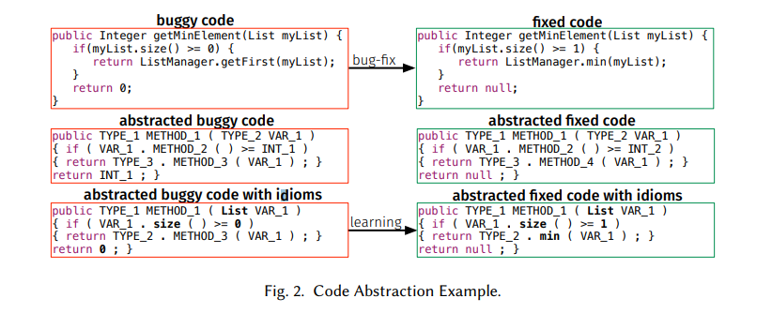
Process
Abstaction
- bfpa = {abstractb,abstractf,A,M}
M mapping to real source code.

Slide 21
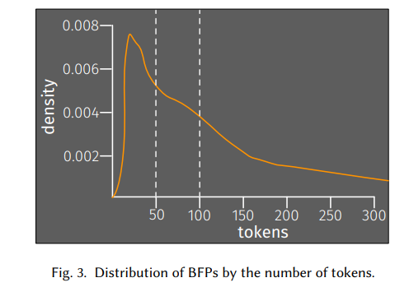
Process
Filtering
1) contain lexical or syntactic errors
2) abstracted code resulted in equal strings
3) performed more than 100 atomic AST actions

Slide 22
Process
Create two BFP small = {bfp<=} BFP medium = 50<bfp<=100}
Synthesis of Identifiers and Literals
- Not have access to the oracle, but only to the input code
- If Id in input code, we can predict and fix

Slide 23
Process
Learning Patches
- We identify similar code to same code because of Abstraction.
- Using NiCad
NMT
- based on RNN Encoder-Decoder (bi-directional RNN Encoder)

Slide 24
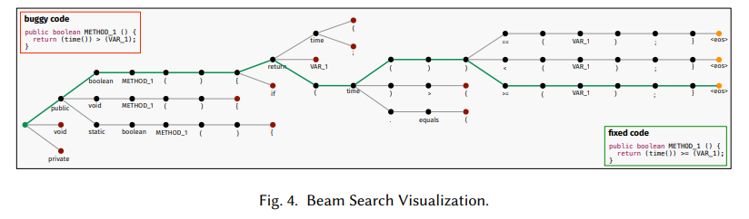
Process
Beam Searh
- To multiple Patches via Beam search.
Decoding process keeps track of k hypotheses.

Slide 25
Process
Hyperparameter Search
- Changing condition , and find optimization
RNN cells, number of layers, units, embedding size
bucketing and padding.

Slide 26
Experimental Design and Result.
RQ1 : Is Nural Machine Translation a viable approach to learn how to fix code?
Use two dataset BFP(small) BFP(medium)
Extracted from CodRep : a Machine learning on source code Competition for External Data
Performing hyperparameter search
find proper hyperparameter for both small and medium. one with 1-layer bi-directional Encoder, 2-layer Attention Decoder both with 256 units, embedding size of 512, and LSTM [31] RNN cells
50k and 55k epochs, respectively

Slide 27
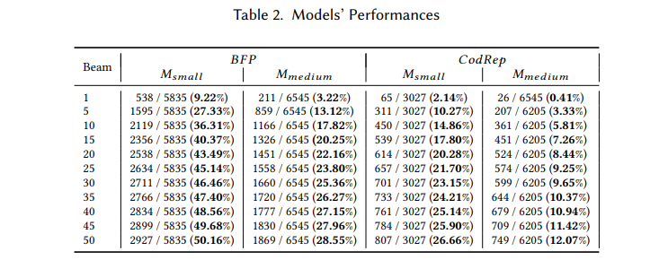
Experimental Design and Result.

Slide 28
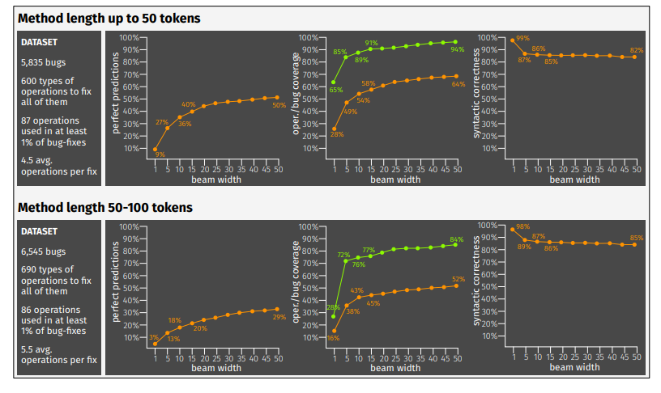
Experimental Design and Result.
RQ2 : What types of operations are performed by the models?

Slide 29
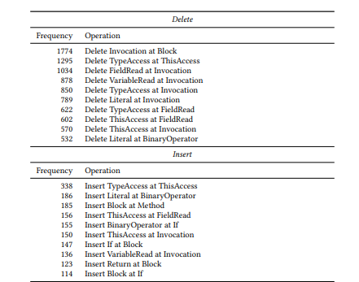
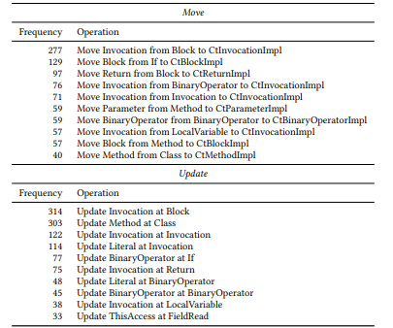
Experimental Design and Result.

Slide 30
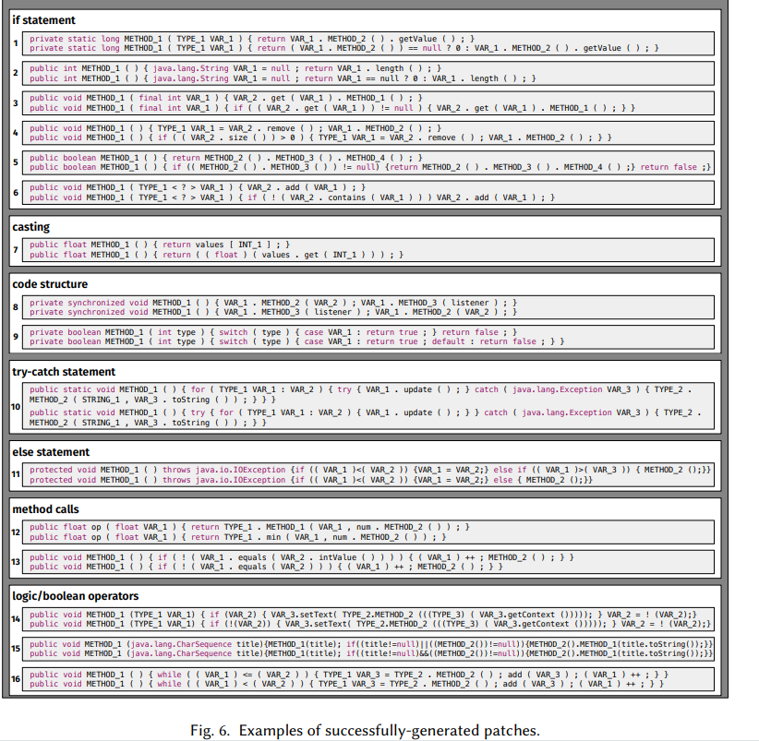
Experimental Design and Result.

Slide 31
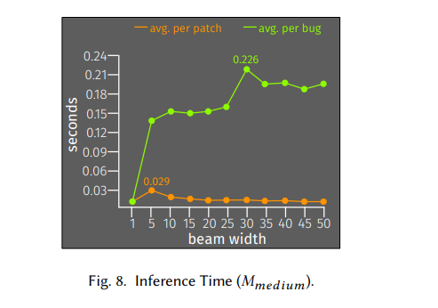
Experimental Design and Result.
RQ3: What is the training and inference time of the models?
- Msmall and Mmedium 6 and 15hours respectively

Slide 32
Threats to Validity.
Construct validity : Threats concern the relationship between theory and observation, and are mainly related to likely sources of imprecision in our analyses.
Internal Validity : performances depends on the hyperparameter configuration.
External validity : threats concern the generalizability of our findings.

Slide 33
Future work
Goal is continue to improve and analyze the model we have generated.
- trade off between training set percentage, model quality and training time.
Focus on two major limitations of the approach
Address a different level of granularity as opposed to function level (increase the tokens size)
Smaller changes within the context of a larger method to keep the context meaningful but still allow the model to change tokens.

Slide 34
Possible
With patches candidates, developer check the validity.
- checking the patch , developer decide whether pass or fail.
- and machine get information , if get fail , provide the next candidate and update the probability or weight for correct answers.
Calculated with provided information, can update the priority of candidate.

